Slide 1
Yelp Project
Randyll Bearer, Raj Patel, Zachary Barlotta
CS1981 - Fall 2017

Slide 2

Yelp/Project Overview
Yelp is a company that helps local businesses connect with customers through reviews and ratings
Yelp bought out NoWait in March 2017
Our Goal: design a voice control UI against the Yelp API such that the user can search for local businesses through Yelp by using only their voice and their Google Home

Slide 3
How We Approached The Problem
Over the semester we encountered a lot of unknown unknowns.
But there were also some things we knew going in.
We definitely needed a verbal language processor
None of us were going to try to reinvent that wheel
We knew we needed a way to deploy what we programmed
We knew we needed to map out some possible conversations
Conversations are complex, like, seriously complex.
Notes:
Unknown unknowns:
- we found out our deployment tools was putting our code on a server which had very sparsely documented auto-threading leading to a lot of data race issues
- Two weeks after deciding to go with the google home and researching and studying how to develop for it, Google completely rebranded and switched software

Slide 4
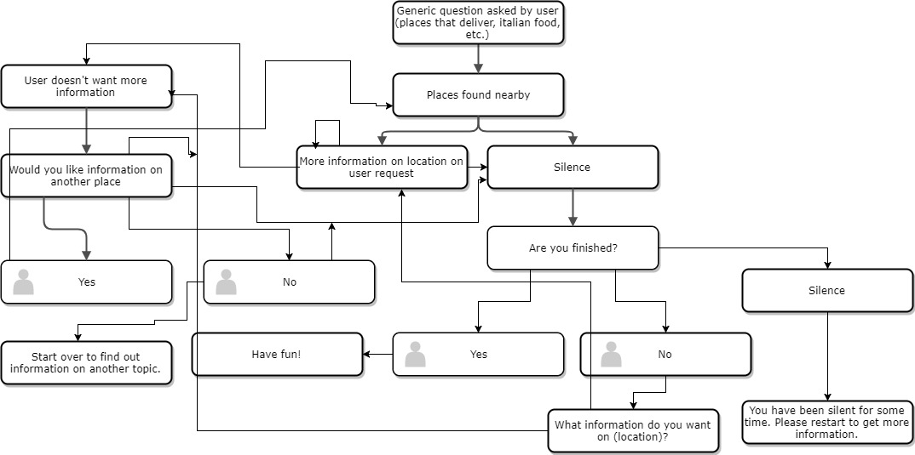
Conversation Flowchart/Diagram

Slide 5
Tools We Considered Using
Other voice ui (Amazon Alexa, Siri)
Siri: Already has Yelp support
Alexa: Simulation did not support voice input
Other servers (Microsoft Azure, Amazon AWS)
Firebase was already integrated into Google services
Final decision: Google Assistant

Slide 6



Tools We Ended Up Using

Slide 7
What We Built With Them
Fusion
API
Public class Yelp{
**********
**********
**********
}
User
Google Assistant
Our Fulfillment
Yelp Backend

Slide 8
A Little Demonstration
https://console.actions.google.com/u/0/project/randytest-46bdf/simulator/

Slide 9
What Yelp Taught Us
Agile/Scrum
Things suggested to us (drop features, add features, etc)
Drop some features, such as wait time
Add to the documentation and versatility of the application
Overall, meetings were very informative and very helpful

Slide 10
What We Taught Us
A lot of JavaScript, mainly our first time
How poorly documented Dialogflow was
How cloud functions work, how useful a procedure for deployment is
Experience communicating with stakeholders (even if our stakeholders were very technical people).

